Slide 1
ENHANCING THE CLUB EXPERIENCE
North Central PETS
March 2022
Title Page Option
Notes:
Hi everyone! Thank you, Patty, for the warm welcome. I am grateful to be here to connect with so many of you. And thank you all for being willing to serve as club president next year. It’s truly a wonderful and crucial role because the magic of Rotary happens in our clubs. You have the ability to have such a positive impact on your club and your community by setting the tone, surrounding yourself with good people, and walking the walk. So let’s dive in today and talk about why our club experience is so important, how to ensure we’re delivering a positive experience, and of course resources to get us there.
Feel free to ask questions or make comments in the chat as we go, or you can raise your hand. Patty is going to be keeping an eye for hands raised.

Slide 2

WHY IS OUR CLUB EXPERIENCE IMPORTANT?
It’s how people:
See
Feel
Experience
Utilize
Interact with Rotary
Notes:
Let’s start here – at the heart of things.
Why is our club experience the most important thing?
Does anyone have ideas?
Incoming president Jennifer Jones

Slide 3
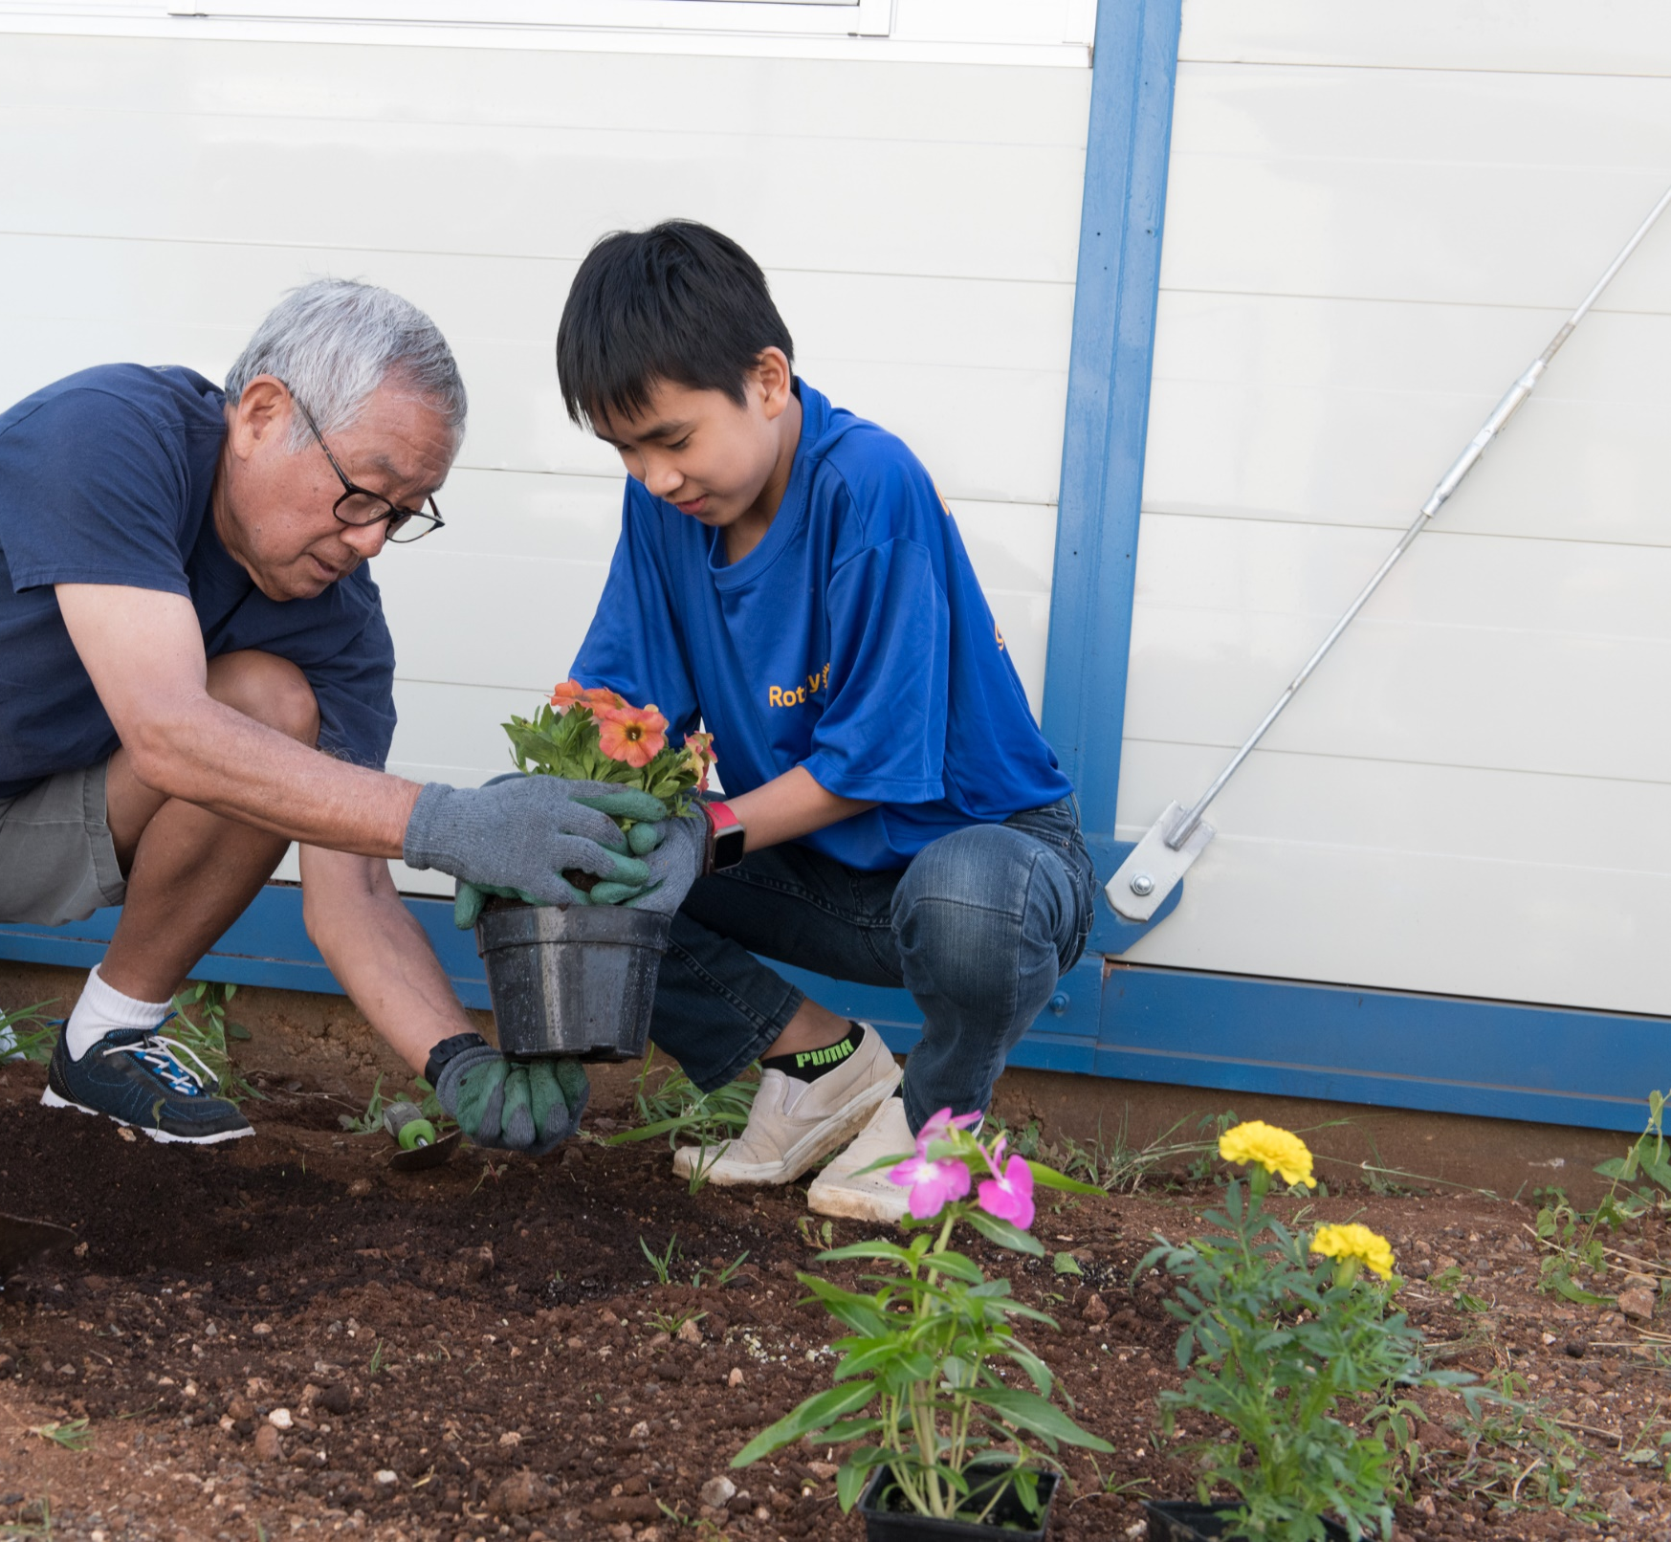



WHAT MEMBERS WANT
Local community service
Connecting with others
Professional & leadership development opportunities
Notes:
So if our club experience, is our product, what do our members want?
Research tells us that Rotarians and Rotaractors have slightly different priorities in their reasons for joining and staying, but generally, they are looking for three things: Local service, connecting with others, and professional and leadership development opportunities.
Through these surveys, we have also discovered a compelling connection between member satisfaction and member retention.

Slide 4

subhead
WHAT CAN WE OFFER OUR MEMBERS?
Leadership development
Personal development
Professional development
Connections + friendship
Service opportunities
Mentoring
Networking
Fun
Notes:
So what can we offer our clubs? Well, really, the sky is the limit. That’s the beauty of Rotary is that we’re so multi-faceted. The list here is not exhaustive – these are just several things we know members want.
At the virtual International Assembly, RIPE Jennifer Jones said, “For Rotary, “finding the right ‘part’ to engage each member should be our core function…It is our offer of hands-on service, personal growth, leadership development, and lifelong friendships that creates purpose and passion.”
In an essence – it comes down to the club experience we’re offering – the opportunities available to our members – and not only making people feel included, heard, utilized, valued – it’s cultivating a sense of BELONGING in our clubs.
This makes me think of HOME. So as you absorb everything, be thinking: What is the role your club plays in your community? Is it people’s “3rd space”? Their outlet? Is it their connection to others in an increasingly connected yet still isolating world? Is your club family? It may be many things to different members, and it’s important you think about all the roles your club plays (homes have lots of different rooms in them with different purposes) - so that you can best support and serve your members and your prospective members which could really be anyone in your community.
Talk about each point.

Slide 5

FACTORS THAT INFLUENCE
MEMBER SATISFACTION:
Comfort with other club members
Club’s positive impact in the community
Confidence in club leadership
Enjoying club meetings
FACTORS THAT INFLUENCE
MEMBER RETENTION:
1. Comfort with other club members
2. Enjoying club meetings
Notes:
Our research also has revealed that feeling welcomed by and comfortable with other club members is the single most important variable when it comes to both member satisfaction and member retention. As comfort increased, the probability of having a higher satisfaction with membership increased as well.
In fact, a member who is not at all comfortable with other members is two to four times more likely to terminate their membership than a member who is extremely comfortable.
This applies not just to current club members, but to anyone and everyone who engages with Rotary. No matter who they are, where they are in the world, or how long they have been connected with us — all members, prospective members, and other participants, deserve and expect to feel valued, respected, and welcomed. This sometimes takes clubs taking a very honest look at themselves and outside themselves – to imagine what it would feel like coming to your club from a completely different background or socioeconomic status or race as compared to the current make up of your club.

Slide 6




subhead
WHY MEMBERS LEAVE
Club environment &
club culture
Unmet expectations
Financial &
time commitments
Notes:
When we ask former members why they left, many cite “unmet expectations.” It’s important to remember this, especially when many clubs are working hard to keep members involved in the midst of a pandemic. 30% of current members say they aren’t satisfied with their club experience.
So, club environment and culture are crucial to the club experience for all members. For Rotaractors, financial and time commitments also play a role in whether a Rotaractors is likely to remain or leave their club.
Imagine being excited to be a member of your local club, only to discover that the experience you were promised isn’t what you got. We also have to be honest with potential members about the club experience and transparent about cost and time expectations. Virtual meetings have opened up new possibilities for meetings, but members also made it clear that virtual meetings interfered with their ability to connect with others and that they should not be expected to pay full cost for virtual meetings.
Clubs have more freedom than ever to structure themselves in ways that work for every member. Accommodating the needs of our members and the community requires flexibility. Virtual meetings might seem like an answer as they have opened up new possibilities, but virtual meetings have to be employed smartly.
There is a club for everyone who would like to make a difference through Rotary. And if there isn’t one, we can create one.

Slide 7

ASSESS
Survey members
HOW DO WE ENSURE A POSITIVE EXPERIENCE?
Club Health Check
Review trends
Identify who’s missing
Check culture
Get non-member feedback
Notes:
So once we understand our club experience is most important for membership retention and attraction, HOW do go about ensuring this?
First, it starts with assessment.
Surveying your club members, and conducting the Rotary Club Health Check with your club’s Board depending on the size of your club.
Reviewing your club’s membership trends through reports in My Rotary.
Taking a look at current demographics of your club and census data of your community and seeing who’s missing.
Once you do that SWOT analysis, be sure to confront any aspects of your club culture that might not be working or welcoming for all people.
And be sure to get feedback from guests, friends, community members, former members, speakers.

Slide 8

PLAN
HOW DO WE ENSURE A POSITIVE EXPERIENCE?
Build a team
Create a vision
Set goals
Be accountable
Notes:
Once you assess, it’s time to create your membership plan. I can’t tell you how many clubs I’ve worked with who are so grateful they actually wrote down a membership plan.
Build a team. Make sure that you’re not doing it all as club president. If you don’t yet have a membership chair identified, please do and report them to RI.
Create your vision for your club over the next 5 years. I’ll highlight some resources that can guide you through this process.
Set goals and enter them into Rotary Club Central.
Then you have a place to come back to to hold yourselves accountable throughout the year.

Slide 9

DELIVER
HOW DO WE ENSURE A POSITIVE EXPERIENCE?
Implement flexibility
Offer opportunities
Check in with members
Engage community
Notes:
And of course, delivering that club experience.
Based on your assessment, member feedback, and vision, implement flexibility if you need to – maybe that means switching one of your meetings to a service project or social.
Make sure you’re offering a variety of opportunities – just like that list we looked at earlier. People are looking for many things.
Check in with your members periodically. Assessment is ongoing.
And be sure to engage your community; through assessment and planning, you should have identified those folks who are missing and a plan to engage them. Maybe this looks like creating a Rotary Community Corps to bridge the gap. Maybe it’s simply about having coffee with someone.

Slide 10
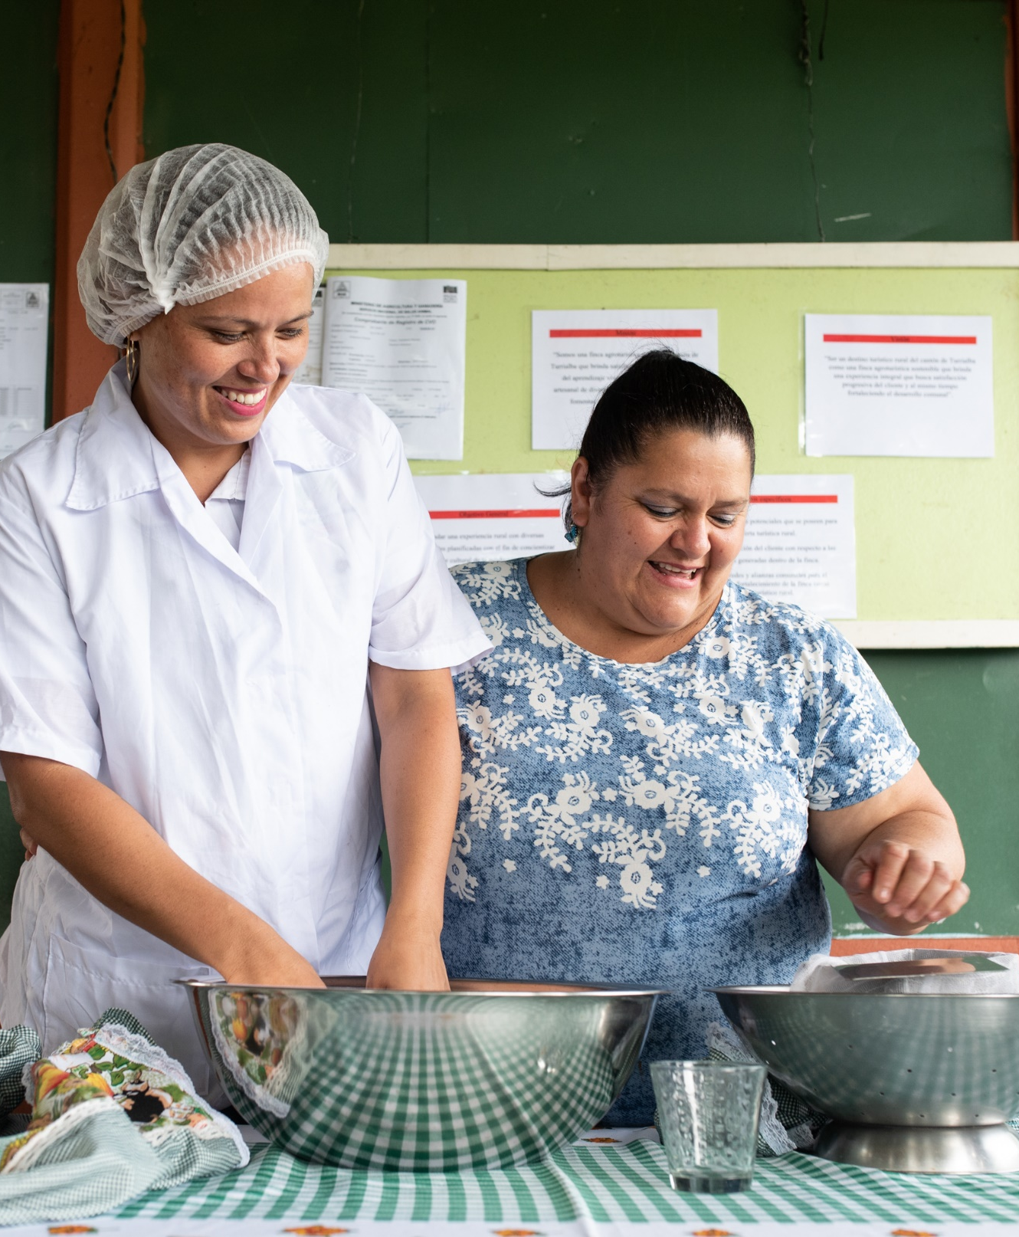
Expand our reach
There are all kinds of leaders in communities, and we want those leaders connected to Rotary.
Let’s open up our thinking about who a leader can be, and then reach out to these new people: start a dialogue about how we can mutually benefit from their participation.
ROTARY.ORG/STRATEGIC PLAN
Notes:
I challenge you all to look around your communities and see all the ways that people are connecting—through shared professional goals, for example, or shared cultures or interests. And let’s invite those people to connect with us, too.
We all want a stronger, more effective Rotary. A Rotary that’s more inclusive and open—to new members and to new ideas. There are so many ways to create new channels into Rotary and all kinds of leaders in communities, and we want those leaders connected to Rotary. So let’s open up our thinking about who a leader can be, and then reach out to these new people. This could mean:
Starting a dialogue with other organizations or clubs about how you can mutually benefit from their participation in your activities and events.
Adopting a cause amongst your club to attract and engage members who are passionate about a specific issue
Including Rotaractors in your activities
Offering a new membership type. For example, offering a corporate membership to attract multiple members of the same company, or an associate membership for younger professionals who want an option that costs less or requires less time.
Forming a Rotary Community Corps Rotary Community Corps with people who share our commitment to changing the world through service projects
So let’s find every opportunity to show we value each and every member and participant. Let’s seize this moment to build on what we’ve learned, to embrace our new reality, to welcome new faces, and to find additional ways to shine. More diverse voices in our clubs and in our leadership will help Rotary stay in touch with a changing world. This is how we will have a continuing impact on the world.

Slide 11
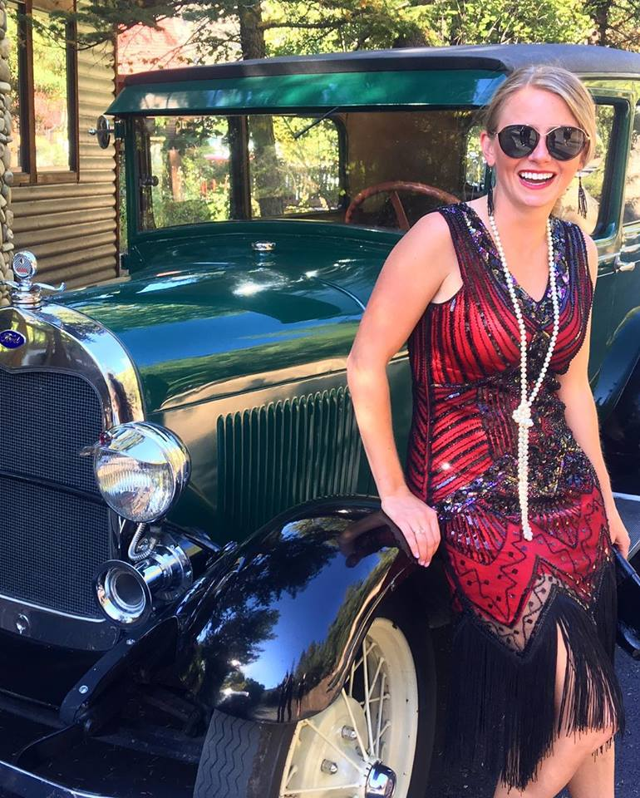
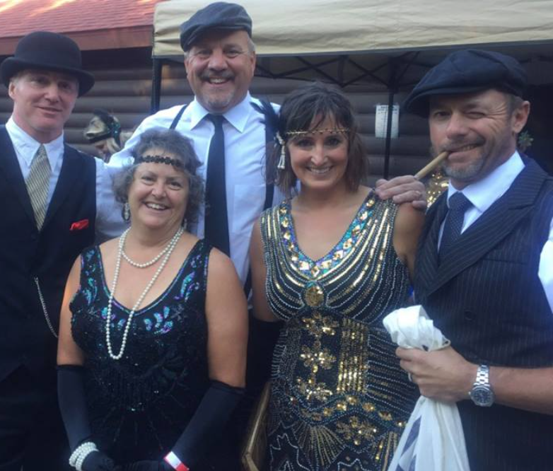

the Rotary Club of clear creek 2000
Clear club vision
Enhanced Rotary visibility
Fun & casual socials
Adapted their fundraisers to engage the community
Notes:
I want to share some clubs with you who are walking the walk so you get some tangible ideas that have worked for others like you.
The Rotary Club of Clear Creek County 2000 in Colorado nearly doubled their membership in 18 months by making simple, but effective changes to how they engage with people in their community. Not only did their small club of 12 members grow to 23, but they grew their female membership from 0 to 7 members! Here’s how they did it:
Socials – They started hosting a couple mixers annually at their local breweries and invited their members and local leaders like the mayor, county commissioners, the newly retired, and others to attend. At the mixers, they offered attendees drinks and hors d'oeuvres, but also made a point to speak briefly about their club, inviting members to chime in with their positive(personal?) club experiences.
Their Cause – At each mixer, they clearly emphasized the focus of their efforts, which was to support the children of Clear Creek County. They did so by sponsoring those attending RYLA, building a greenhouse for the high school, and providing a weather station for science students.
Visibility – The club decided to try out new fundraisers to engage both new and existing members in a fun and unique way. They did so by hosting the “Mobster Lobster Fest” where live lobsters are flown from Maine and folks come dressed up in costume. The funds raised from the event are used to create academic and vocational scholarships for students.
Culture – Their meetings feel like a “giant round table” welcoming members, while encouraging new ideas, friendship, and comradery

Slide 12
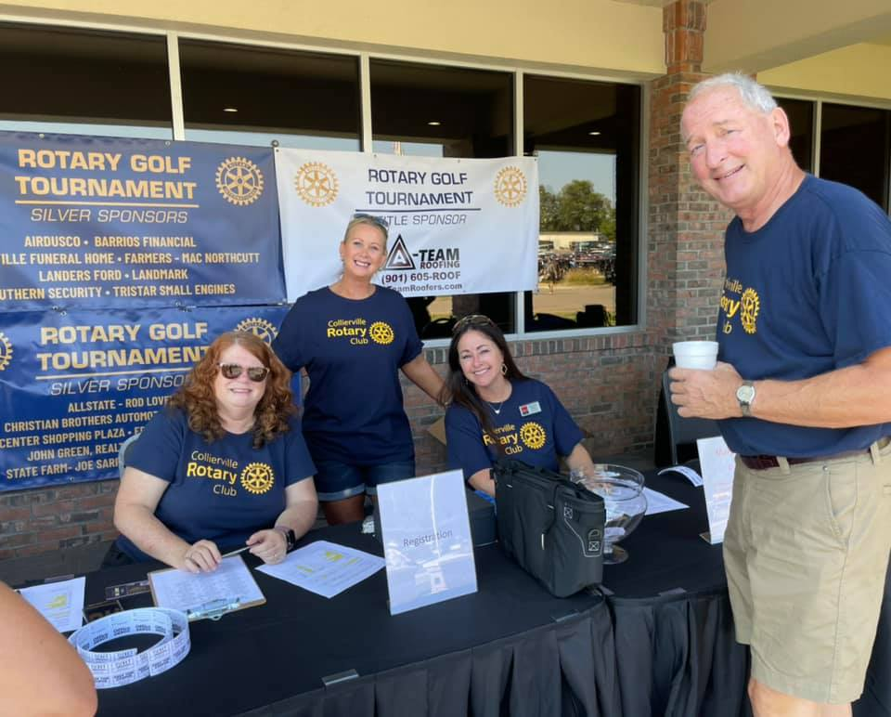
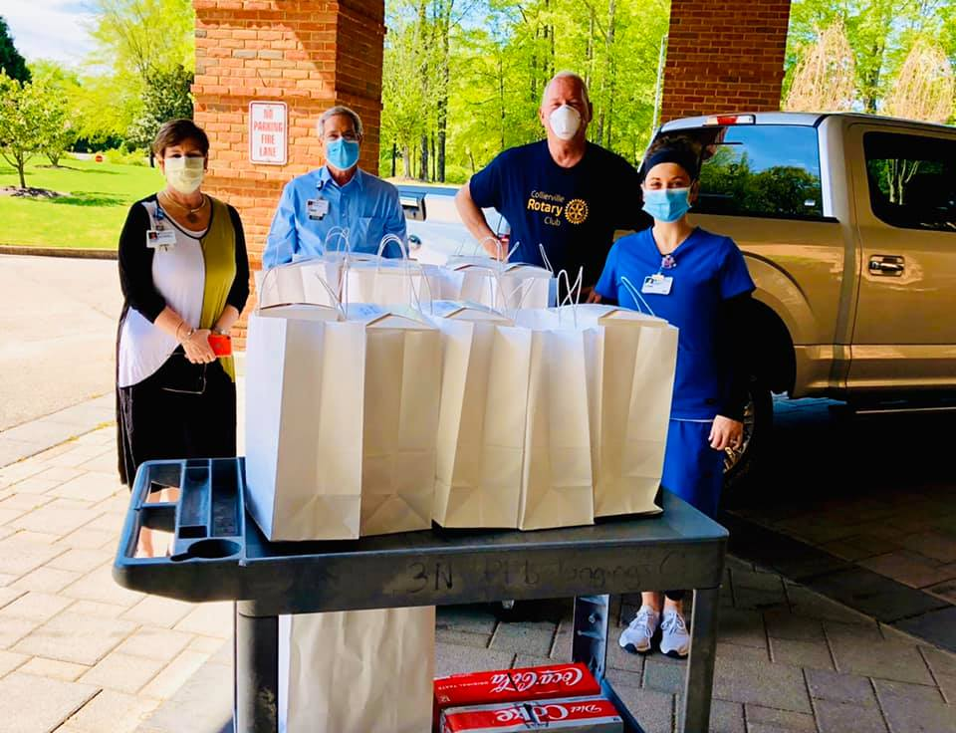
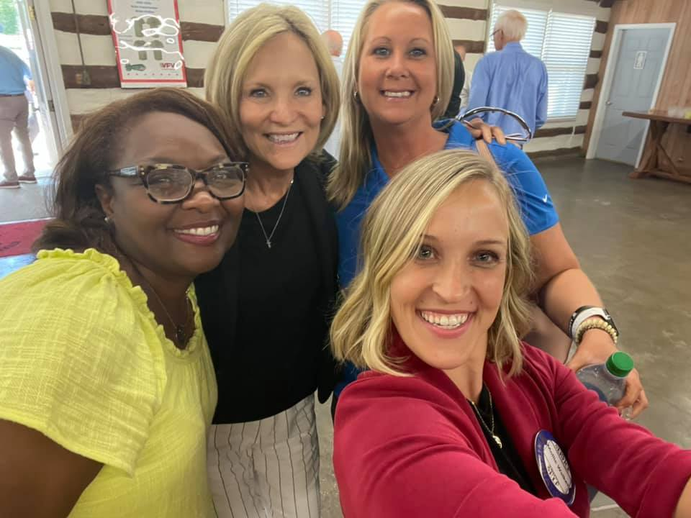
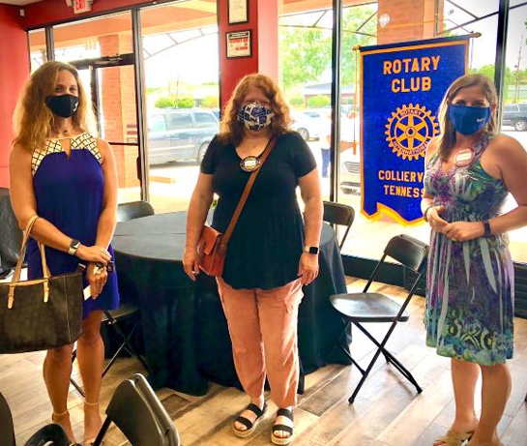
the Rotary Club of collierville
Corporate memberships
Storytelling through social media
Hybrid meetings
Embraces diversity
Notes:
Next, the RC of Collierville:
Is it possible to grow your club in the midst of a pandemic? We have found the answer to be a resounding yes. Despite all the challenges that COVID-19 has presented to Rotary clubs and the entire world, really, there are ways to excite members, engage in service, and through creativity attract people who are interested in joining us as people of action.
Last June, we set a goal to grow by 20%, and so far we have welcomed in 13 new members. Why 20%? Back in the early 2000’s our club had 100 members. But our membership declined over the years. If we grow 20% each year, we figure we can get back to 100 members within three years if not sooner. We knew this would be a challenge, but like in business or sports, you set a target and build a plan to achieve it.
Here is how we did it:
We started corporate memberships in July which has helped us get new members as more than one person can attend the meeting. We modeled our corporate membership after Rotary guidelines where there is a primary member but if they cannot attend they send an alternative. This has helped us attract members who would not normally join. Several of the corporations have headquarters in Collierville like Muellar, MCR Safety, Alston Construction. This has enhanced the club via resources and also the ability to attract other corporations and change the image of Rotary.
We set a goal of attracting more women and young professionals so we did not look like “the old guys club.” We put female members and younger members in charge of projects that increased their visibility in the community and made them ambassadors to attract other prospective members. When people saw we had young professionals and women in our club, more were attracted. And these prospective members saw the value of what we were doing. Of our 13 new members, six are women.
We created an online application that made it very easy to fill out all the information required.
We organized service projects that built awareness of the club and helped attract people who want to do service work. We rang the Salvation Army Bell this year at one location and it got high participation from members and their families. We set a goal of raising the most money of any Salvation Army location in the Greater Memphis Area which we did. During the bell ringing we had several people come up and ask how they could join Rotary because they wanted to be part of something like this. The Salvation Army is a great cause because they help so many people in need and most of the funds go to the needy vs administration/overhead. And everyone who rings the bell tells you it is a very rewarding personal experience. Many bring their children to participate so they can witness the “giving by others.” We just won the Non Profit of the Year Award from the Chamber of Commerce because of our service.
We told our story via social media so non Rotarians could see what we are doing to support our community, want to be part of a successful team, and come join Rotary. Each week we do a profile story on a member so people can see who is in Rotary and something about the person. We also post on Facebook every time we have a club meeting where we talk about the speakers or recognize people. When we have events like Salvation Army, we take pictures of the bell ringers and encourage people to donate. This gets the name of Rotary in front of people as its “the best kept secret” as some of our members say.
We provided meeting options, meeting in person (except for December and January) with the option of attending by Zoom if you could not attend in person. We follow health department guidelines and post them the day before the meeting so Rotarians know what to expect. Our county essentially shut down in December and January due to an increase in COVID and our speakers were limited due to access to Zooming their stories. (Learn more about holding engaging online meetings)
We embraced diversity. Diversity brings increased energy and new ideas. If you have projects that are very appealing it helps you attract young members. Plus, young members have children and they understand the value of vaccinating children to prevent polio, or providing Christmas gifts, or ringing the bell for the Salvation Army, or sponsoring a Gift of Life Child for major heart surgery from Honduras.
We are not done growing this year. I hope we get another five to eight new members before year end. We will be remembering the year of COVID-19 as the year we grew our membership in double digits. How about your club?
https://blog.rotary.org/2021/05/06/7-tips-to-growing-membership/#more-11918

Slide 13
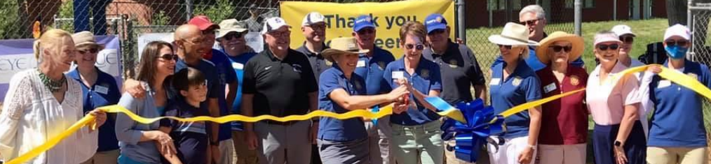
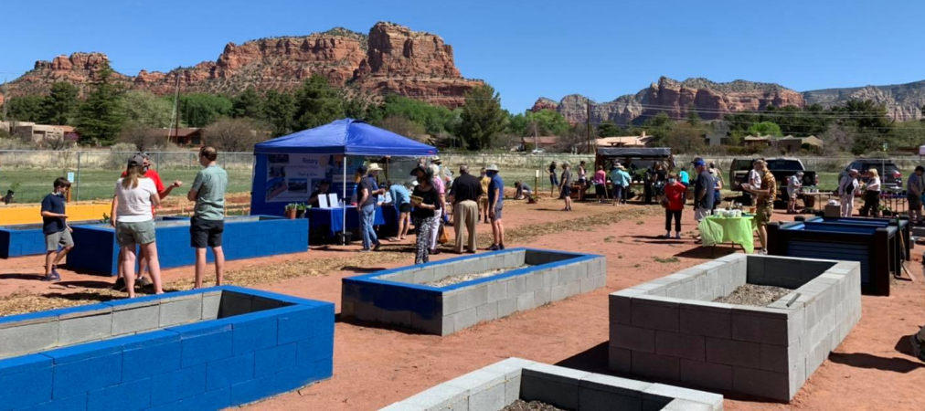
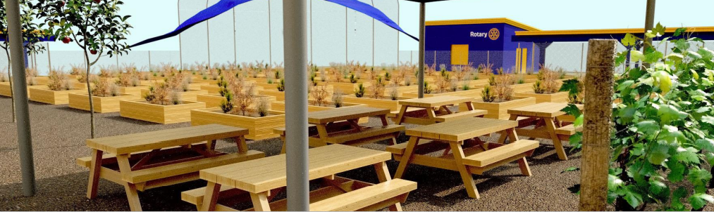
The rotary club of Sedona village
Community Assessment
Designed project based on pandemic needs
Inclusive to local organizations
Notes:
Sedona Village Rotary inspired their city and attracted 15 new members through a new service project, building a community garden. The idea came by listening to the community's biggest needs at the start of the pandemic: 1.The scarcity of food and 2. The desire to connect outdoors. The idea was met with enthusiasm from the club, members of the community, and local businesses/ organizations and quickly grew into the passionate project for which everyone rallied. Club President Heather Hermen shares “We know that this is working because the community is showing up. They’re participating, and they’re engaging and they’re watching. They’re digging their hands into the soil with us.” Listen to the beautiful story of this incredibly dynamic and engaging project in an interview from District 5495 Governor Elect Larry Horton in their podcast here: The Membership Blueprint - Whooshkaa

Slide 14
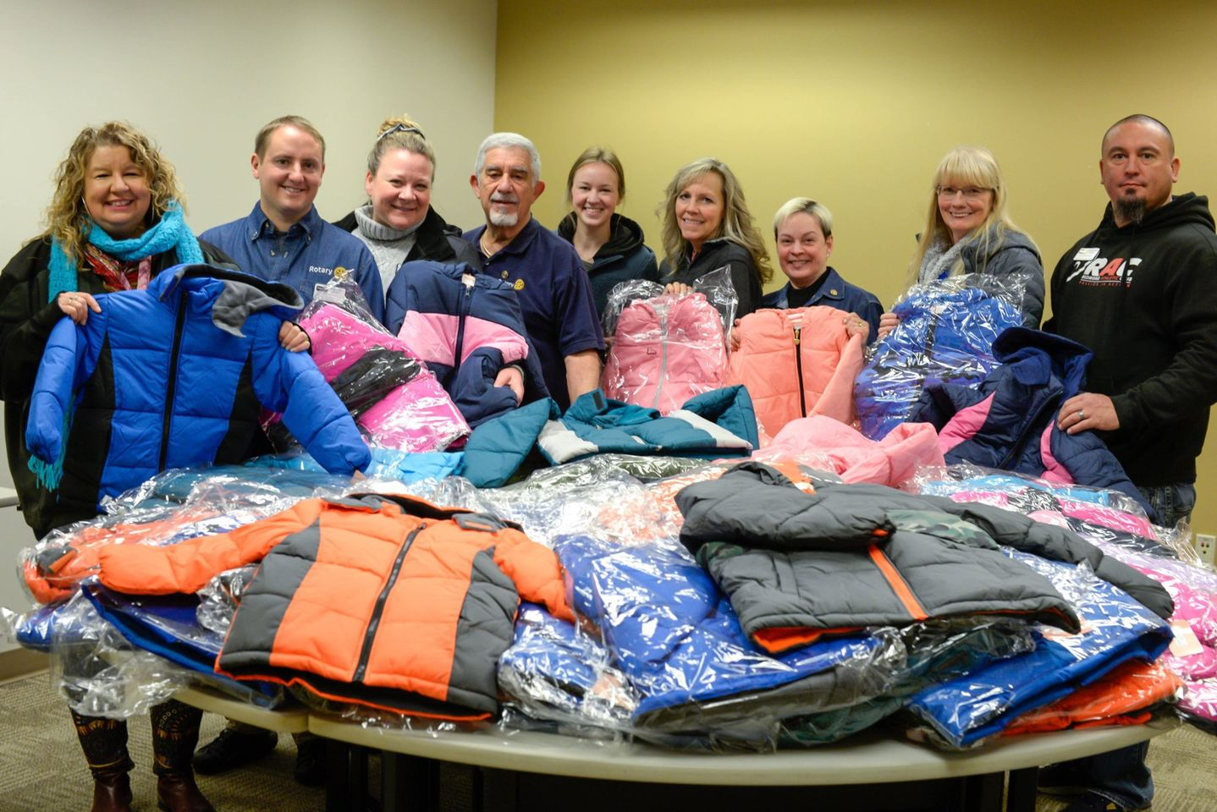
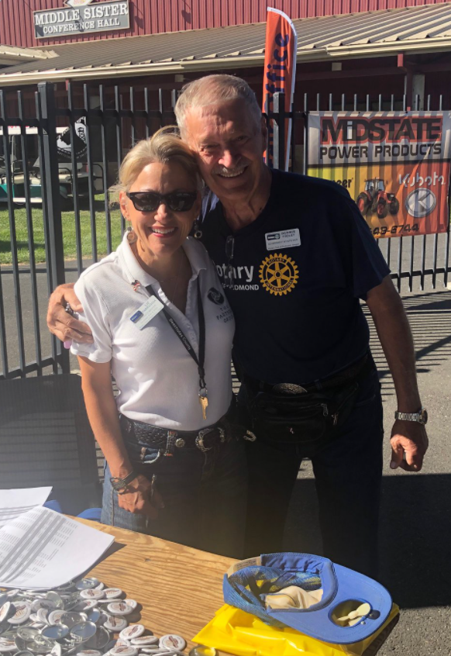
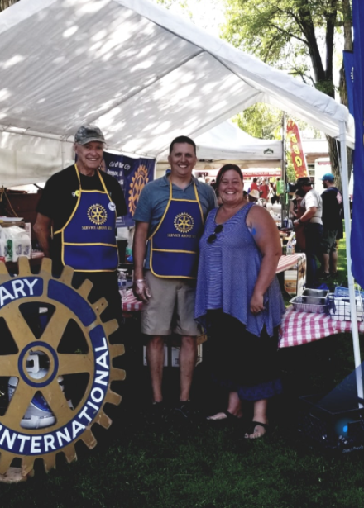
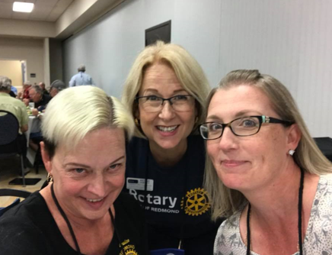
the Rotary Club of redmond
Intentional hospitality
Personal introductions
Mentors new members
Family friendly
Membership Committee spreads out at meetings
Notes:
The Rotary Club of Redmond has reached their membership goal of 45 members, grown by 41% since 1 July 2018, and transformed their membership into a highly engaged group of doers. These successes came from good leadership, effective trainings, and a continued focus on club assessment. Here’s their story:
Current Membership Chair Beckie Sibley first joined the Rotary Club of Redmond in October 2017 after being matched through RI’s Membership Leads program. She found her new club to be very unwelcoming but loved what Rotary stood for and was determined to stick with it. Soon, she was asked not only to join the membership committee, but to be their chair for the 2018-19 year. Beckie seized the opportunity and in preparation, she and 5 others attended the Priority One Training facilitated by zone coordinators hosted within District 5110. Inspired, she brought back new tools, resources, and strategies to her club. This is when the club started to turn things around and revitalize how they engaged with new and existing members.
The club decided to implement several changes, but here were some of the biggest takeaways:
Show your hospitality. Make sure your meetings and events are warm and welcoming. Follow up with guests and make sure the outreach is sincere and genuine.
Make introductions personal. Don’t just describe someone by their job or how long they’ve been in Rotary, but include their hobbies, their passions, and accomplishments.
Mentor new members. Help them identify their own goals for joining the club.
Make it family friendly. Their club’s fireside chats always encourage members to bring their children, grandchildren, and family friends.
Spread out the Membership Committee at meetings. It’s a great way to engage with all members of the club.
Attend trainings. Beckie gives a lot of credit for their club’s evolution to the Priority One Training and for the Strategic Planning training offered by her district.
We’re so impressed with the positive club culture the Redmond Rotary Club has developed and wish them the best on their future endeavors!

Slide 15

CLUB FLEXIBILITY
FORMAT
CLUB MODELS
ATTENDANCE
FREQUENCY
MEMBERSHIP TYPES
Notes:
Next, I hope you’re aware of these aspects of flexibility, but in case you’re not, let’s go over them quickly.
Research tells us that clubs that have more freedom to determine how they hold their meetings, who they invite to membership and what defines engagement - are more vibrant and have a greater ability to grow.
There are many ways that clubs can utilize flexibility to meet prospective and current member needs, simply by updating your club bylaws.
Meeting format –Obviously we’ve seen the pandemic force clubs to change their meeting format. And some are finding they can engage people who were no longer attending in person meetings because of their schedule. A “meeting” can also be a social, a service project, a tour of a local business – the sky is the limit.
How often does Rotary actually require you to meet or gather? Anyone know? Meeting frequency can vary, as long as clubs offering two opportunities to meet or gather per month. Be sure to enter any additional meeting details into My Rotary.
Clubs can offer different membership types – corporate, associate, family, young professional. You’ll still report members as active or honorary, but you’ll keep track of it locally.
There are many different club models that have emerged over the years– cause-based clubs, passport clubs, satellite clubs – we have guides on My Rotary for many of these. Some clubs will revitalize themselves by adopting a cause or shifting the focus of their club.
And of course, clubs can relax or tighten attendance depending on what works for you. Encourage engagement over attendance – and having multiple ways to participate helps with that.
(ASK ATTENDEES WHAT’S WORKING FOR THEM & WHAT CHALLENGES THEY’RE EXPERIENCING WITH FLEXIBILITY)
CLICK

Slide 16




SHAKE UP
YOUR CLUB
Notes:
Now we’re going to play a little game because we’ve all been on Zoom a lot!

Slide 17
●●●●●●●●●●●●●●●●●●●●●●●●●●●●●●●●●●●●●
1
2
3
4
●●●●●●●●●●●●●●●●●●●●●●●●●●●●
●●●●●●●●●●●●●●●●●●●●●●●●●●●●
5
6
●●●●●●●●●●●●●●●●●●●●●●●●●●●●●●●●●●●●●●●
Notes:
Since I can’t pick one of you to roll the dice, I’m going to do it for us. We’ll then jump to the numbered question, and I’ll ask for volunteers for how we can solve the club experience issue.

Slide 18

When your meetings are boring, unwelcoming, and/or poorly attended…

Slide 19
When 6 of your
new members
leave in the first year…

Slide 20
When you realize your club members are unwilling to try something new…

Slide 21
When the same few members always do everything…

Slide 22
When your longer-tenured members and newer members aren’t mixing…

Slide 23
When you realize your community has no idea what your club does…

Slide 24
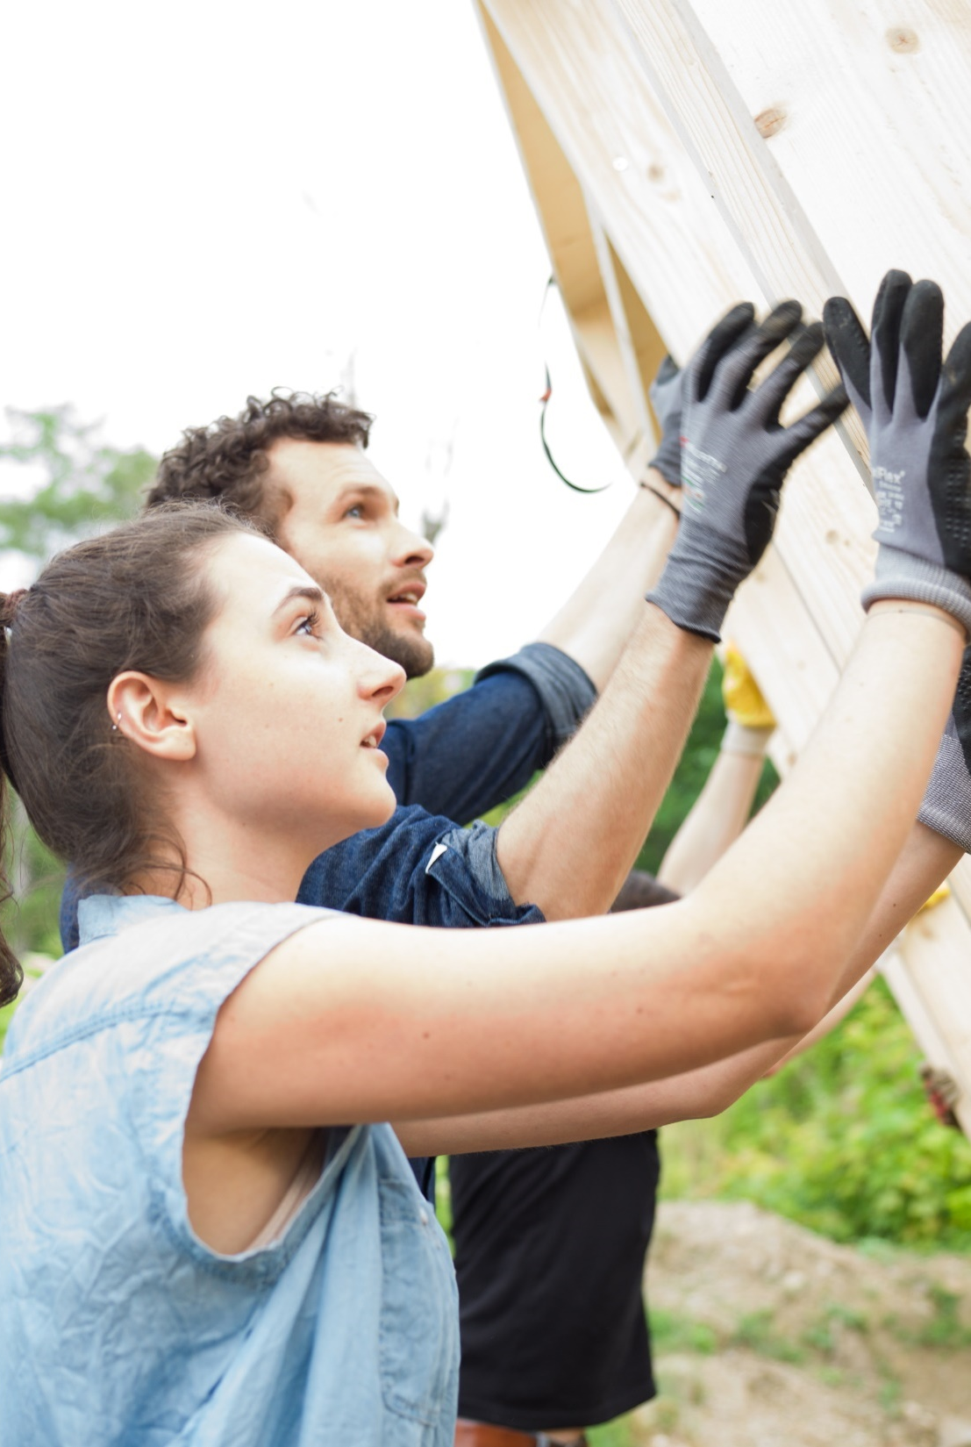

RESOURCES
Strengthening Your Membership
Club Health Check
Member Satisfaction Survey
Strategic Planning Guide
Rotary.org/Membership
Rotary.org/Learn
Rotary.org/DEI

Slide 25
QUESTIONS?
Reach out!
Regional Membership Officer
Emily Tucker
Emily.Tucker@rotary.org
847-866-3258

